Slide 1
STRESS SURVEY FORM
GROUP PROJECT

Slide 2
Objective
Currently, we are in a society where mental stress has dominated individuals still it is considered taboo, and we are unable to talk about it.
It will provide complete information regarding stress and its causes.
This form will create awareness and help us to know about the students who are facing stress silently.

Slide 3
TEAM MEMBERS CONTRIBUTION
SANDIP SHARMA(20BCS5132) and SHIVAM SHARMA(20BCS5148) have created Survey Form and Thank You Page with the help of HTML and CSS
SHIVAM SINGH (20BCS5176) handled the Back-End-Part which includes storing the form data in database and updating it on our next page for users
LAWANYA ARORA (20BCS5131) handled our Landing Page and Information Site with the help of HTML and CSS

Slide 4
CONTENTS
01
02
03
SECTION
SECTION
SECTION
04
05
06
SECTION
SECTION
SECTION
SOFTWARE USED
LANDING PAGE
INFORMATION WEBSITE
SURVEY FORM
DATA STORED
FINAL PAGE

Slide 5
WHOA!
LET’S START

Slide 6
01
SOFTWARE USED
The Whole Project is divided into Two Parts: Front End and Back End

Slide 7
SOFTWARE USED
Front End Software's:
HTML
CSS
Back End Software's:
PHP
MySQL
XAMPP
Operating System: Windows 10, Windows 11
IDE : Visual Studio Code, Notepad++, Sublime Text

Slide 8
02
LANDING PAGE

Slide 9

FIRST LOOK OF OUR WEBSITE -

Slide 10
03
INFORMATION WEBSITE

Slide 11
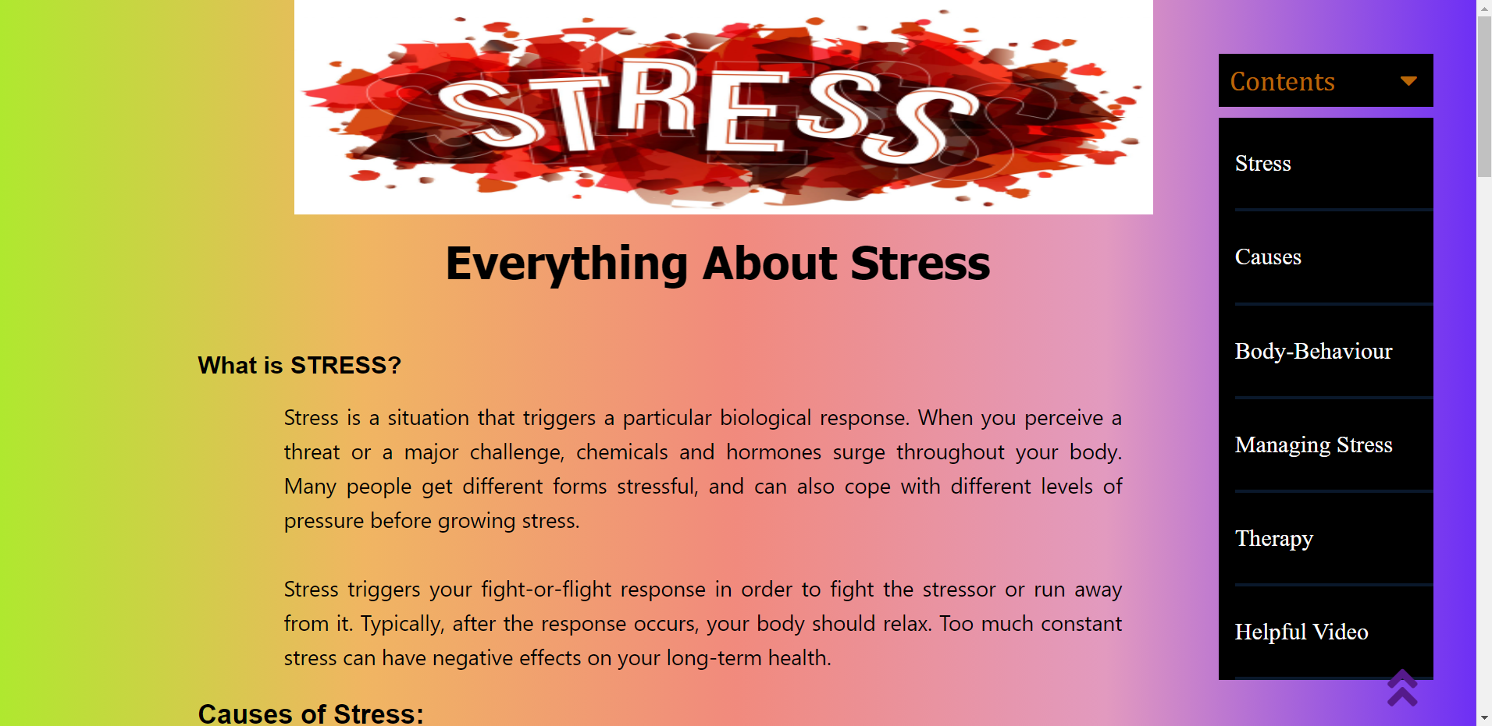
This Slide Represents Our Second Page Which Contains All The Information Related To Stress.
This Page Is Built To Help Our Users Understand This Topic Before Filling Our Survey Form.

Slide 12
04
SURVEY FORM
This Section Is Divided In Two Segments

Slide 13
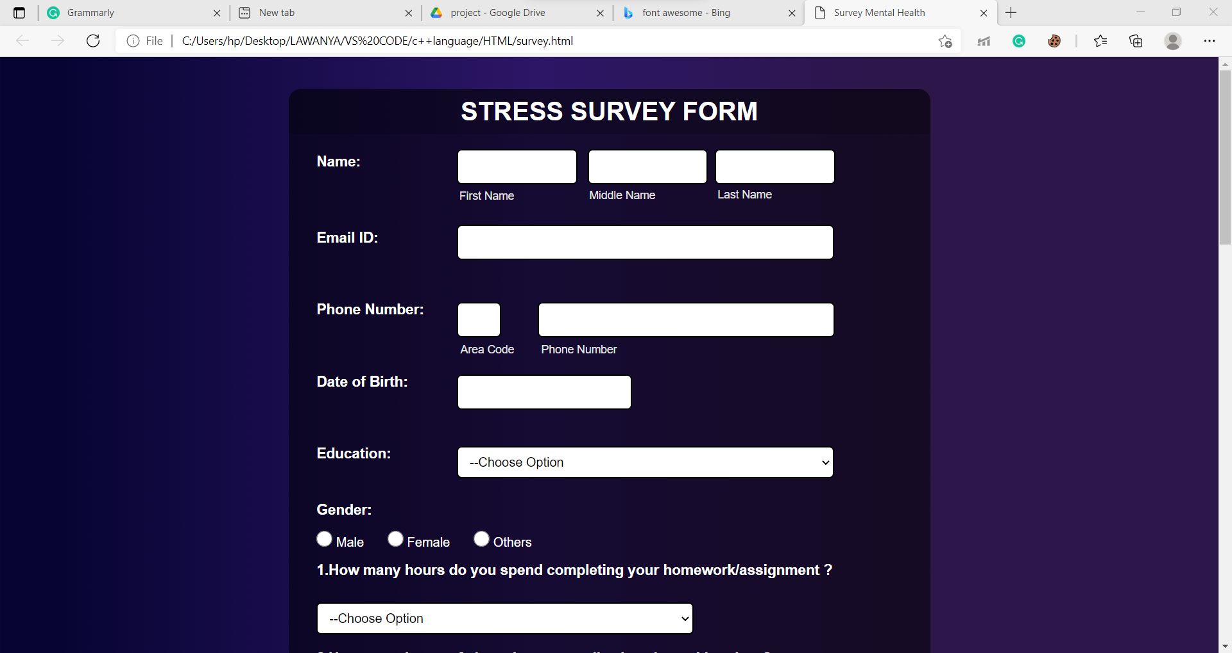
In the first segment,we are Collecting User Personal Information as shown here:

Slide 14
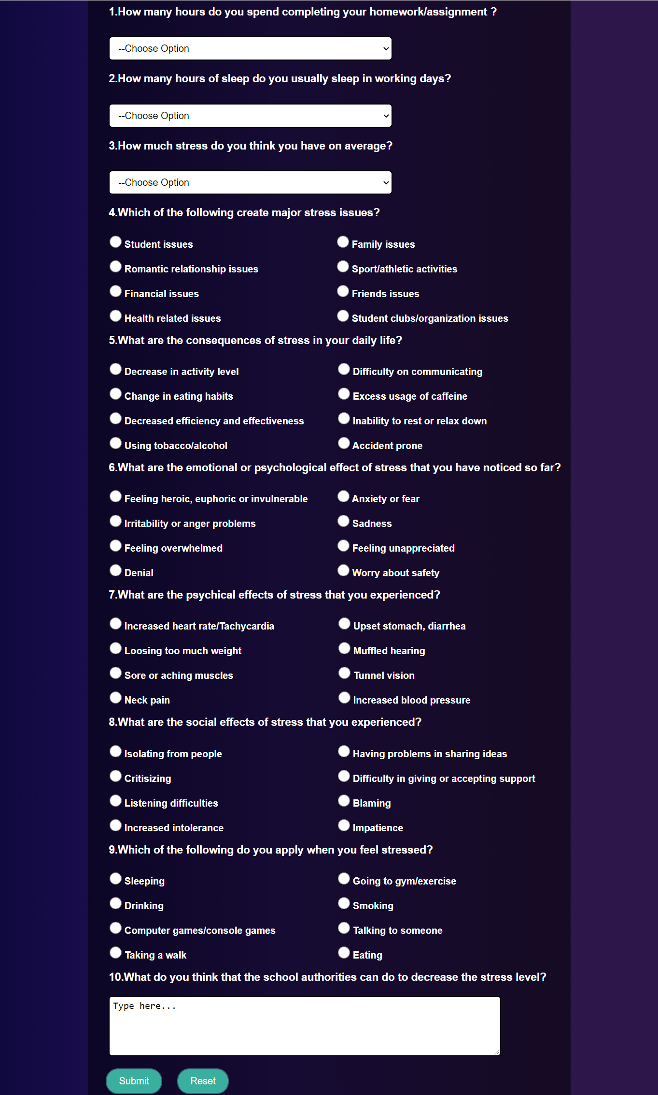
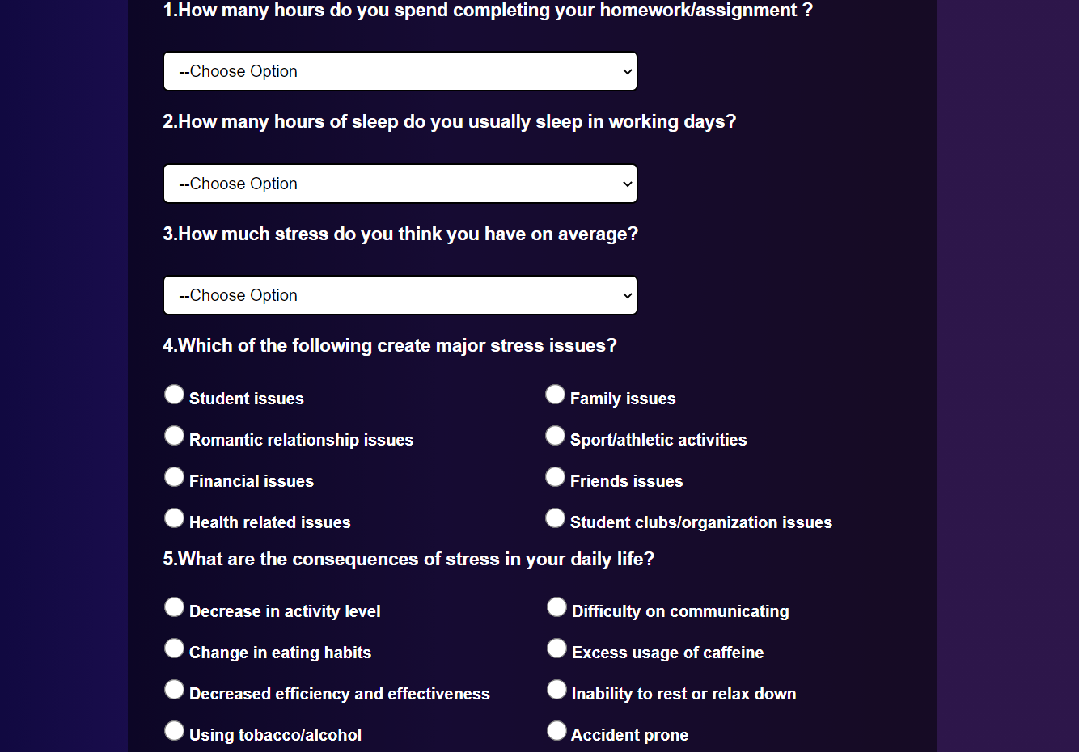
By further scrolling this page, one can view our 2nd Segment which include all the questions related to stress which are required for this survey:

Slide 15
05
DATA STORED

Slide 16
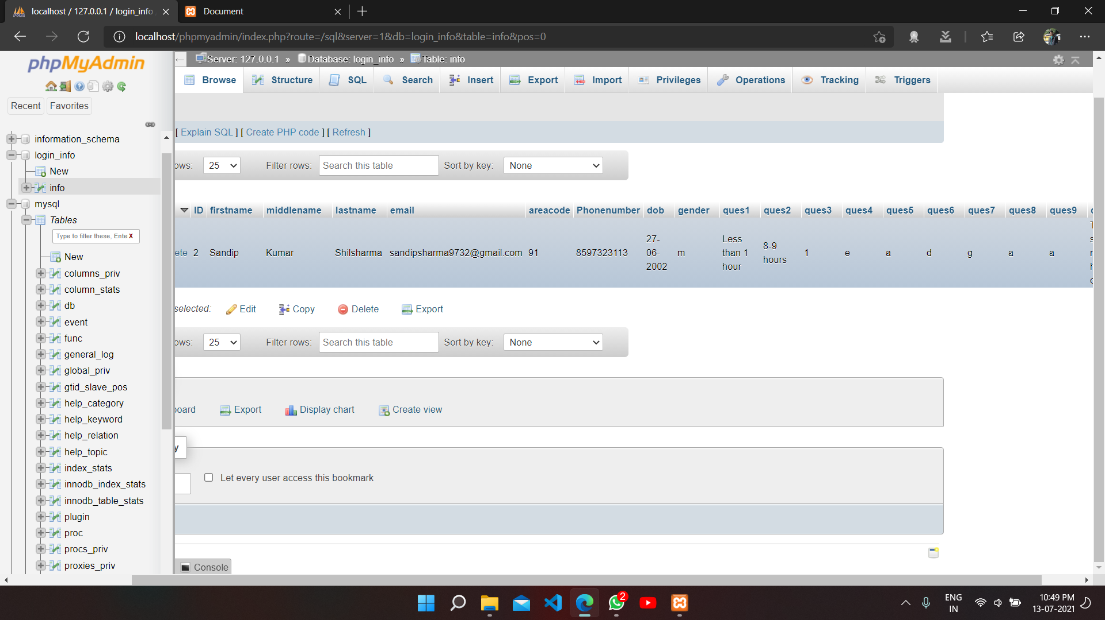
ALL The data will be stored in this table with the help of sql and php

Slide 17
06
FINAL PAGE

Slide 18
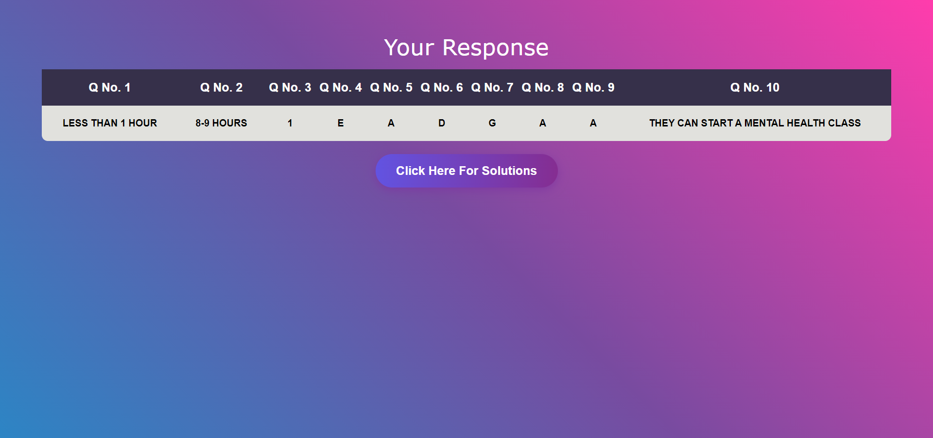
After Submitting the Survey Form, this page will open, which WILL CONTAIN USER INFORMATION AND A SOLUTION PAGE

Slide 19
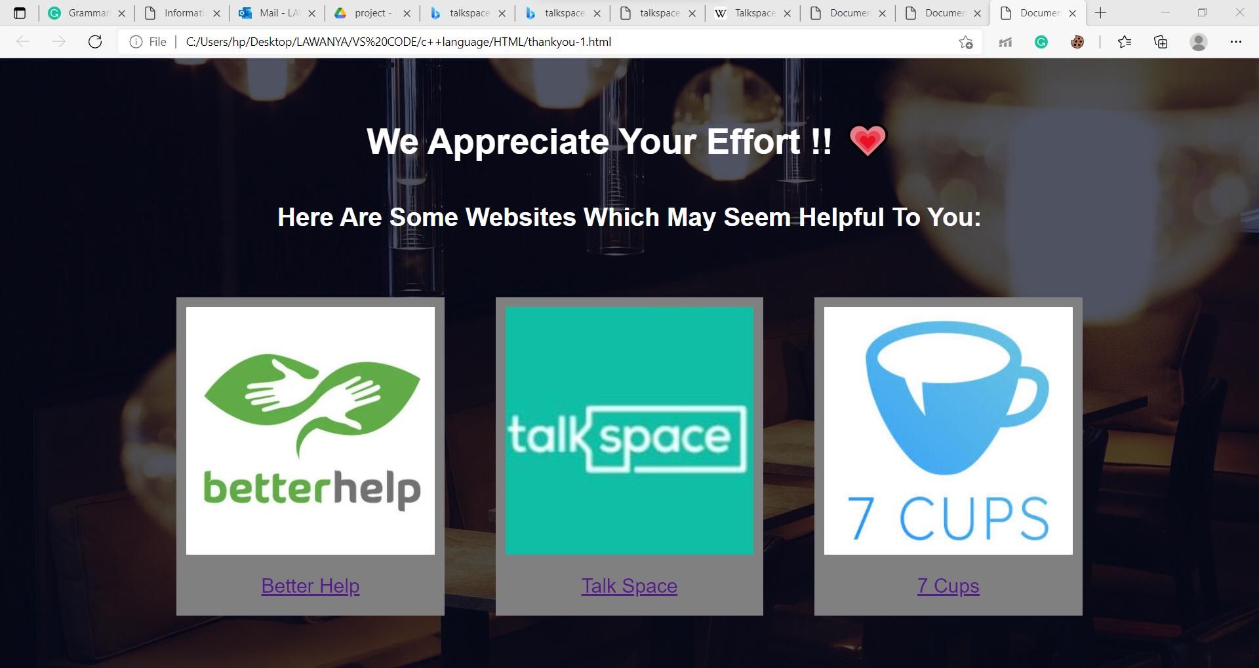
SOLUTION TAB

Slide 20
FUTURE SCOPE
As the main objective of this project is to create a survey form for students. So In near coming future we will be working on to add many more functionalities. For example :
Providing Full Report and Proper Analyse from Questions.
Adding extra helpful features and resources for Suffering Peoples.
Designing a more user friendly website.

Slide 21
REFERENCES
W3schools
Php.net
Csstricks.com
Bootstrap
Font Awesome
Freecodecamp.com

Slide 22
GOOGLE DRIVE LINK Project code files and all other resources are summarized in this google drive link. https://drive.google.com/drive/folders/1dZjYENGyqmO885oInOkOZKYiXPDB_xnw?usp=sharing
Project Codes And All Other Resources Are Summarized In This Google Drive Link
https://drive.google.com/drive/folders/1dZjYENGyqmO885oInOkOZKYiXPDB_xnw?usp=sharing

Slide 23
THANK YOU

